Slide 1
Rent Consultation 2024-25 Review

Slide 2

The Assurance challenge
Evidencing and measuring
Meaningful feedback and input
Clear process through to Governance and Assurance
Tenant Consultation – what we need to do….
The Housing (Scotland) Act
Meet Charter outcomes
What does it actually mean
to tenants and the organisation….

Slide 3
How does this fit Assurance? The route of the Business Plan…
Governing Body scrutiny
Review of Business Plan
Tenant consultation
Pre-budget – timely/influential
VfM and service delivery input
Assurance
Business Plan/Budget GB proposal and approval
Shapes Scrutiny Projects
Stress tested operationally
Efficiency review

Slide 4

Sector challenges
2023
Alleviating Homelessness
Compliance Standards
Emphasis on tenant support
High level
of inflation
Energy Efficiency and EESSH 2 Targets
Net Zero Scottish Government Ambitions
Value for Money and affordability
Interest rates changes
Scottish Government new homes target – delivery of 100,000 by 2032
Energy
Costs

Slide 5
Delivering a fundable business plan
Debt Affordability
Service Delivery Levels
Financial Viability
Sufficient Investment
Can withstand Risks
Rent Affordability

Slide 6
How we assess Affordability
Scenarios of households – economic status & household makeup
Scenarios of income - Living wage, Local Housing Allowance
Comparison to Mid market and private rent by postcode analysis, benchmarking

Slide 7
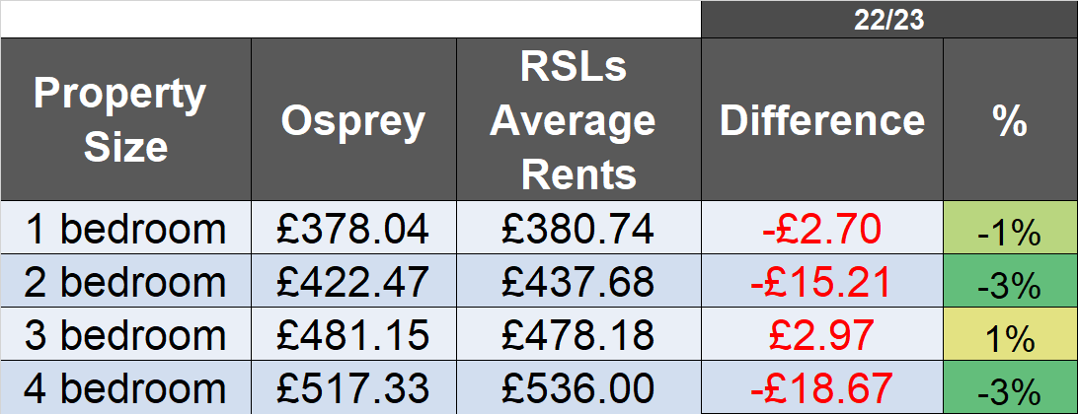
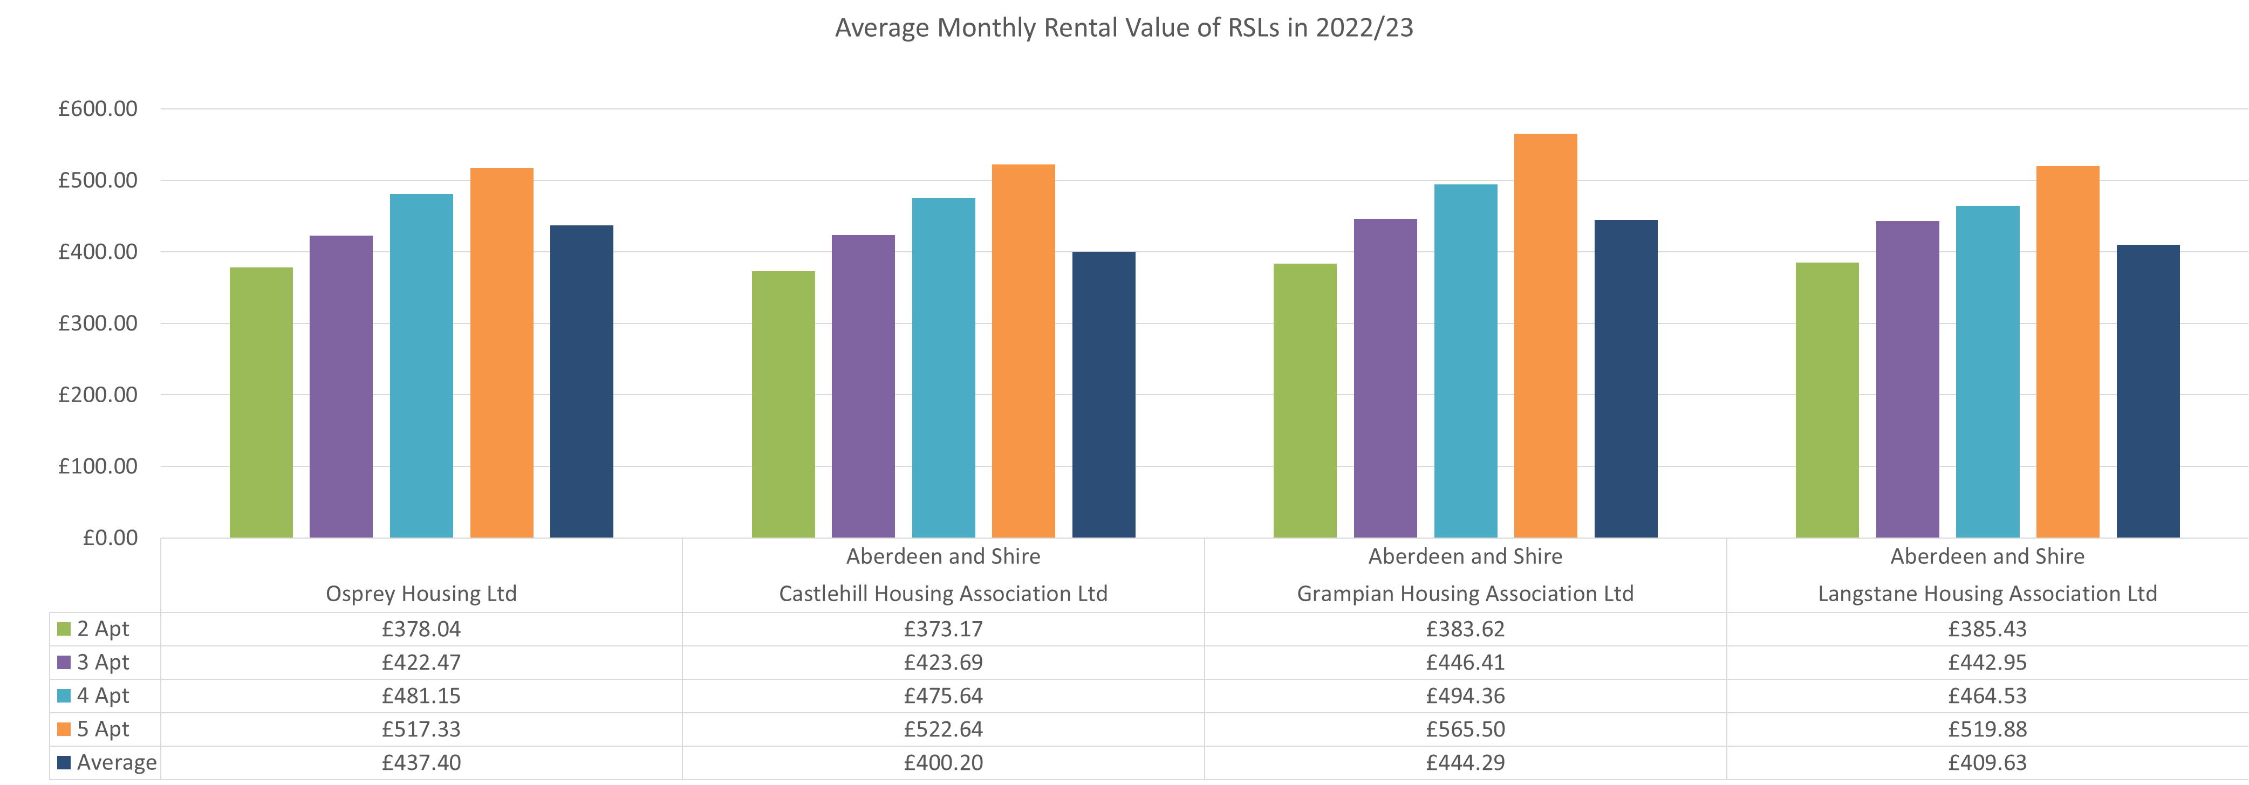
How do Osprey rents compare to locally operating RSLs? (2022/23 vs RSL ARC 2021/22 Data inflated)
2%
On average Osprey rents are now 2% lower than peer RSL Rents, with 2 & 4 bedroom properties the most competitive

Slide 8
What have we done to date?
 | Osprey | Scottish average rent increase | Inflation (CPI)
2021-22 | 0% rent increase | 1.2% | 0.5%
2022-23 | 0% rent increase | 3.3% | 3.1%
2023-24 | 4% rent increase | 5.3% | 10.1%

Slide 9
Is the 2024 business plan fundable in the future?
We initially need to focus on the short term planning for the next five years ahead.
Also ensuring that we remain financially viable for the medium and long term, testing against the next 30 years of the Business Plan.
What does the 2024 Business Plan look like?
The income required to run the Osprey Housing Group comes predominantly from tenant rents.
To sustain the plan we have reviewed a variety of rent increases to consult on.

Slide 10
Where we are spending our money
Management costs remain stable while managing more properties each year. Based on current assumptions we anticipate the cost per unit to fall to around £1300 next year – value for money
Increasing budget to invest in our properties – reactive repairs, planned and cyclical programmes and investment upgrades
Increased specific investment into Energy efficiency and home safety

Slide 12
Baseline assumptions & Impacts on rent
Baseline assumption for 2024-25 = 6.7%
Options to smooth out current higher inflation
All affordable with equal long term impact on business plan
 | Year 1 | Year 2 | Year 3
Option 1 | CPI = 6.7% | CPI | CPI
Option 2 | CPI – 0.5% = 6.2% | CPI + 0.5% | CPI
Option 3 | CPI – 1% = 5.7% | CPI + 0.5% | CPI + 0.5%

Slide 13
Example of impact based on 2023-24 average rent of £454.22
 | Year 1 | Year 2 | Year 3
Option 1 | £484.66 | £501.62 | £516.67
Option 2 | £482.38 | £501.68 | £516.73
Option 3 | £480.11 | £499.31 | £516.79

Slide 14
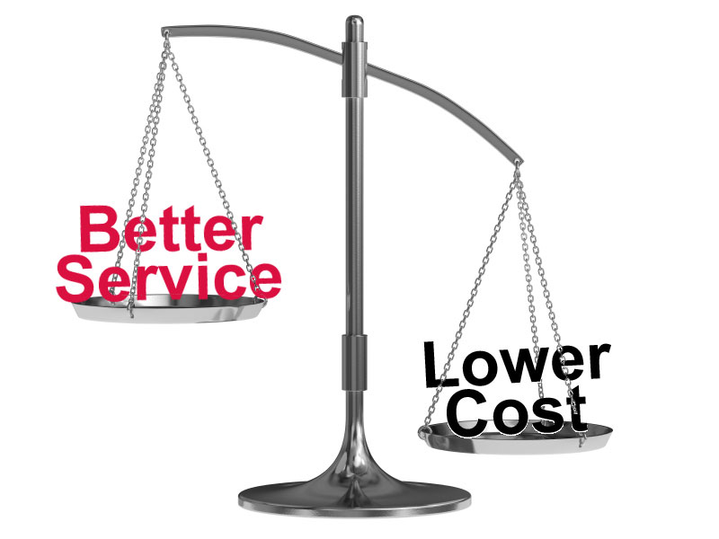
Value for Money
Getting the balance right
Listening to tenant feedback from satisfaction days
Understanding tenant priorities when designing our services
Continual improvement

Slide 15
Tenant satisfaction survey results
 | 1 How satisfied are you with the overall service provided by Osprey Housing? | 2 Overall, how satisfied or dissatisfied are you with the quality of your home? |  | 6 Taking into account the accommodation and services provided, do you think that the rent represents good or poor value for money?
Percentage very satisfied/satisfied | 91.73% | 90.76% |  | 84.65%
Scottish average 22/23 | 87% | 84% |  | 82%

Slide 16
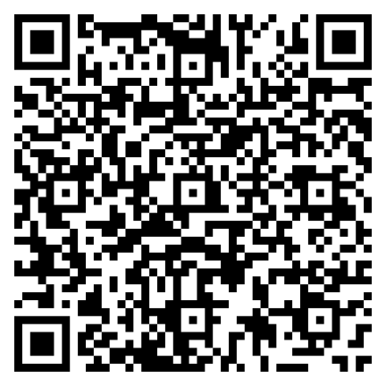
To provide your feedback please follow this link:
https://form.jotformeu.com/Ospreyhc/rent-consultation-survey
We would like to know more about what your priorities are as a tenant. We have listed these below.
Value for Money/Affordability | Support & Advice – Financial/Debt
Quality of Home - Repairs and Maintenance | Support & Advice – Digital Access/Getting Online
Quality of Home - Property Upgrades | Support & Advice – wider tenancy support
Energy Efficiency | Keeping Tenants Informed/Tenant Participation

