Slide 1
2023 Tenants report
A report on our performance on the Scottish Social Housing Charter

Slide 2
This report is created with Osprey tenants to share our performance over the previous reporting year. Enabling you to understand how our performance compares to the Scottish average and that of our local peers.

Slide 3
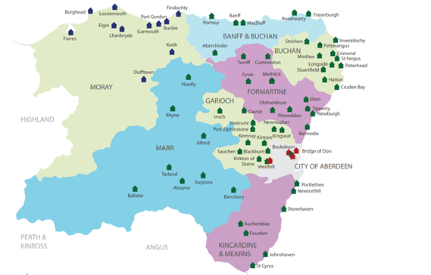
OTRA says… “OTRA continue meet on a monthly basis as we review organisational matters and performance reports to ensure that tenants are receiving the best possible service and value for money. OTRA play a vital role in ensuring that the tenants are at the heart of all decisions as we work with Osprey staff to improve the services being offered. We are actively looking for new members to join OTRA. Please contact Osprey if you wish to get involved in shaping the services that we receive”.
Aberdeenshire;
1119 General needs properties
14 Specially adapted supported units
Moray;
563 General needs properties
4 Supported units
Aberdeen City;
87 General needs properties

Slide 4
Tenant satisfaction

Slide 5
Tenant satisfaction is a key indicator of how we are meeting the needs of our customers. Ospreys outcomes against each of these indicators either exceeds or meets the national average
IND 1 – Satisfaction with overall service provided by their landlord
IND 2 – Tenants feel that their landlord is good at keeping them informed about services and decisions
IND 3 – Opportunities given to them to participate in their landlords decision making process

Slide 6
Quality of Housing

Slide 7
Osprey Housing has consistently performed well against repair indicators. This correlates against local performance and the Scottish average with outcomes being very similar.
Last year Osprey invested over £1.6 Million in the renewal of kitchens, windows, doors and other components to better the quality of our existing stock.
Organisation | Emergency repairs | Non emergency repairs | Right first time | Satisfaction with repairs | SHQS year end
Osprey Housing | 2.4 hours | 7.4 days | 95.4% | 98.8% | 97.3%
Scottish average | 4.2 hours | 8.7 days | 87.8% | 88.0% | 79%
Angus HA | 2.2 hours | 4.3 days | 94.7% | 93.3% | 87.7%
Castlehill HA | 3.4 hours | 6.4 days | 88.1% | 91.3% | 99%
Grampian HA | 2.9 hours | 8.6 days | 94.4% | 82.8% | 81.6%
Langstane HA | 3.7 hours | 7.8 days | 80.3% | 74.3% | 91.3%

Slide 8
Value for money

Slide 9
 | Osprey Housing | Scottish Average
% Rent collected | 98.7% | 99%
Gross rent arrears | 4.61% | 4.5%
Rent increase applied | 4% | 5.1%
At Osprey we have worked hard to provide the right level of support to tenants during a tough economic period. A lot of work has gone into providing suitable advice and help to tackle arrears cases, this allows us to continue to invest in our existing stock and the newbuild programme.
Avoiding bad debt is essential to meet our future ambitions and being proactive in our approach to rent management has helped us to deliver rent freezes during two of the previous three years.
We continue to invest in our staff team with a particular focus on tenancy support. We have many examples of how this additional help has been of benefit to our tenants.

Slide 10
Access to Housing

Slide 11
The average time to relet properties is significantly below the Scottish average. Osprey has also performed well against local benchmarks.
Having quick turnaround times enables us to house those who require alternative housing quickly and efficiently, benefiting our customers and maximising our income.

Slide 12
Osprey maintain our own choice based lettings system ‘These Homes’ which we allocate properties through, including all internal transfer. We also work in partnership with Aberdeenshire, Moray and Aberdeen City Councils, with whom we take direct nominations for our properties.
We work hard to make the best use of stock by allocating homes to applicants who either have specific needs or property size requirements. By utilising ‘These Homes’ we have enabled applicants to have more choice in where they want to live and the type of property that they wish to live in.
We remain committed to providing 50% of all vacant properties to homeless applicants.
Method of allocation | Total
Homeless applicants | 37.1%
These Homes | 25.4%
Council nominations | 24.2%
Internal transfers | 10.8%
Very sheltered housing | 2.5%

Slide 13
From our CEO
“I am pleased to be sharing with you the performance outcomes for Osprey for the 2022-23 year. Despite a continuing challenging operating environment the team have continued to put tenants first and achieve strong performance across the range of indicators.
At a time when the cost of living continues to rise, putting household finances under real pressure we will continue to focus on affordability and supporting our tenants as best we can going forward.
Managing our void performance and arrears directly impact on our income and how we can efficiently and effectively manage the organisation to ensure we continue to invest in our properties through our repairs service, capital improvements and energy efficiency investments. Therefore, our performance being consistently strong across the range of performance indicators is particularly vital to how we can improve your homes.
We continue to review how we operate and how our teams deliver services to our tenants, the engagement of OTRA and the social media tenant group is invaluable to this process. We need to hear your views and constructive feedback to be able to meaningfully ensure we meet tenants needs and priorities now and in the future”.
Stacy Angus
CEO

Slide 14
Help us to shape the services that we deliver!
There are a number of ways to get involved with Osprey. If you would like to be involved in future decisions around how we deliver our services to you be it in person or online then please get in touch, we would love to hear from you!
Follow us on Facebook;
Osprey Tenants & Residents Association (OTRA) | Facebook
Or use the contact information on the back page of this document to get in touch.

